Slide 1
Multi-Role User Management System Using React & Spring Framework
SUMAPRIYA-2420030337
Y.V.GOKUL-2420090027
VINEETH G-2420030375
ROHITH-2420030783

Slide 2
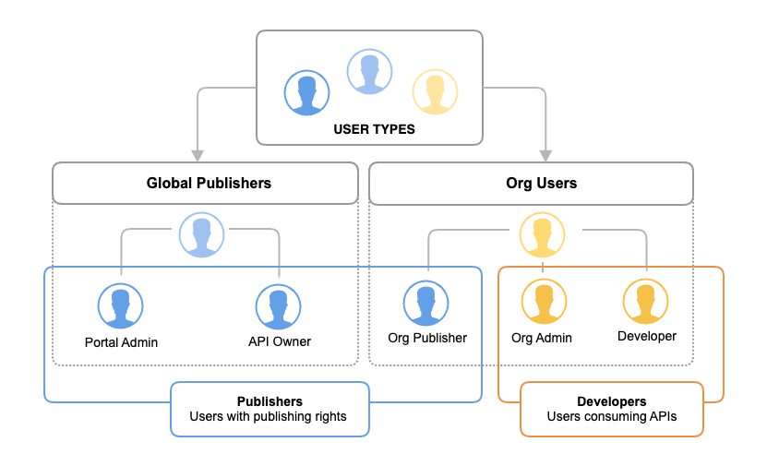
Problem Overview
Applications require role-based access control to ensure security and proper data management. Different users in a system need different levels of access and permissions. Without role-based systems, applications become insecure and difficult to manage. This project focuses on building a system that supports multiple user roles efficiently.

Slide 3
Objectives
The main objective of this project is to develop a system that can manage users and roles effectively. It aims to provide secure access control based on user roles.
The system should support efficient data handling and scalability for real-world applications.

Slide 4
Tech Stack
Frontend: React.js is used to build an interactive user interface. Backend: Spring Boot is used to handle business logic and APIs. Database: MySQL is used for storing user data. API: REST APIs are used for communication between frontend and backend. Security: JWT authentication is partially implemented.

Slide 5
System Architecture
The system follows a three-tier architecture.
The React frontend sends requests to the Spring Boot backend through REST APIs.
The backend processes the requests and interacts with the MySQL database.
The database stores and retrieves user information as required.
.

Slide 6
The database stores and retrieves user information as required.
The core management module handles user and role management. CRUD operations are implemented to create, view, and delete users. APIs such as POST /users, GET /users, and DELETE /users/{id} are used.
This module forms the foundation of the entire system.

Slide 7
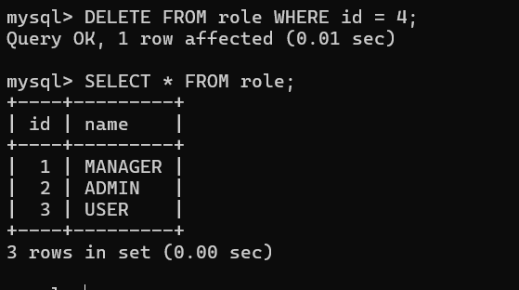
Role-Based Structure
Roles such as ADMIN, USER, and MANAGER are defined using an enum.
Each user is assigned a specific role. This structure allows implementation of role-based access control.
It helps in restricting or granting access based on user roles.

Slide 8
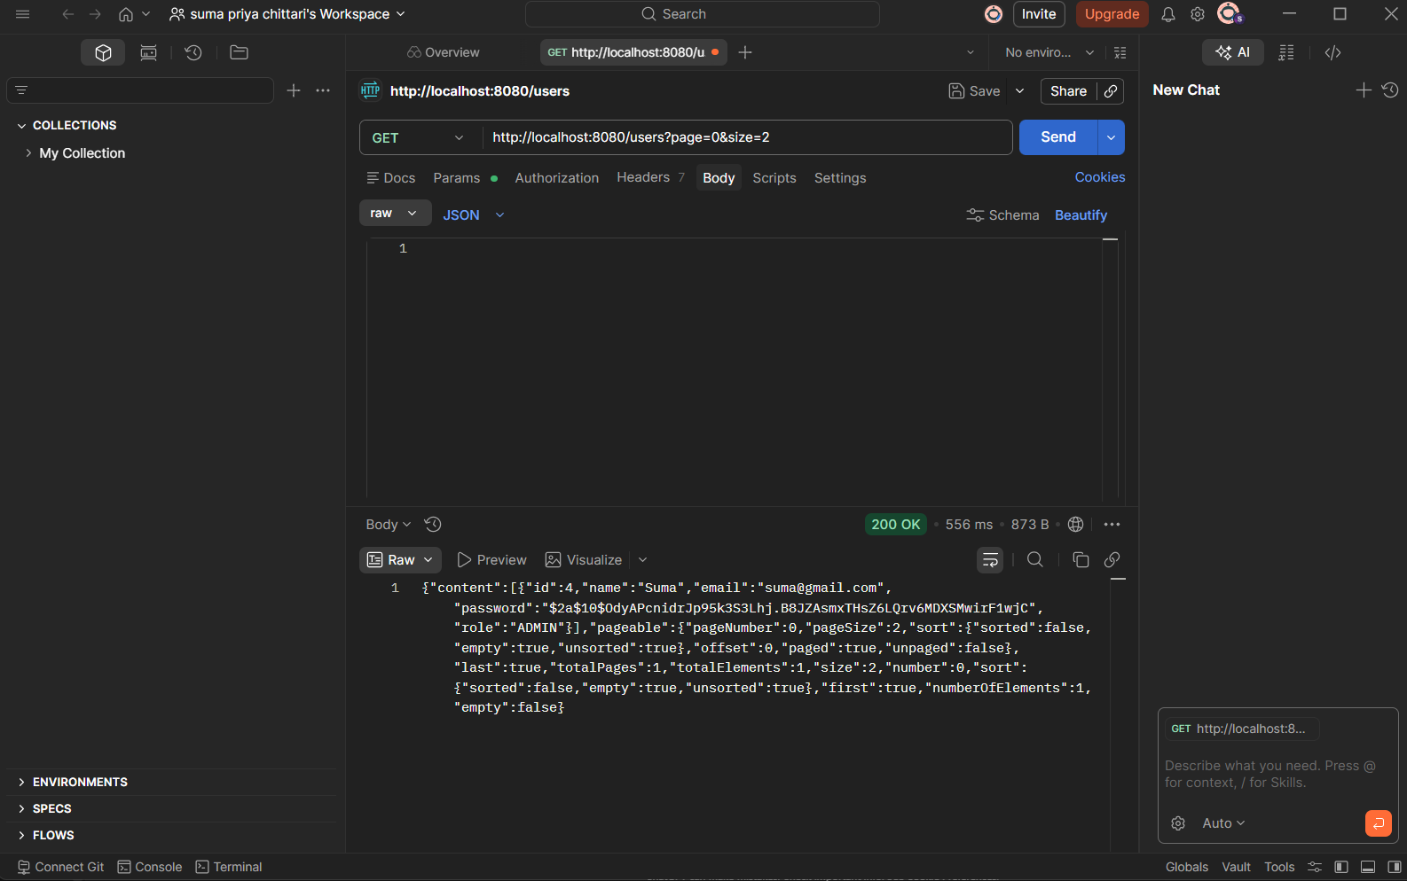
Search and Filter Module
The system supports filtering users based on roles. API endpoint GET /users/role/{role} is implemented. For example, /users/role/ADMIN retrieves all admin users. This improves usability and data retrieval efficiency.

Slide 9
Database Integration
The backend is connected to a MySQL database. Hibernate is used for automatic table creation. Data persistence is achieved, ensuring data is stored permanently. All CRUD operations interact with the database successfully.

Slide 10
Frontend Module The frontend is developed using React. It includes pages such as Login, Register, and Dashboard. Users can register, log in, and view data. The frontend is connected with backend APIs but currently has a basic UI.

Slide 11
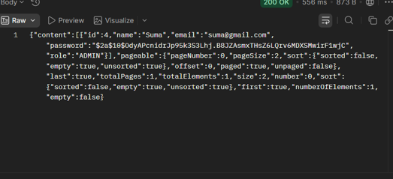
Authentication (JWT)
A basic JWT authentication system is implemented. A login API is created to authenticate users. Upon login, a JWT token is generated. However, the token is not yet used to fully secure APIs.

Slide 12
Partial Modules
Pagination and sorting are partially implemented using APIs like GET /users?page=0&size=5. Analytics module is planned to count users by roles but not fully integrated. Basic exception handling is implemented using @RestControllerAdvice. These modules require further improvement.

Slide 13
Limitations
Role-based authorization is not implemented yet, so all users can access APIs. Passwords are stored as plain text instead of being encrypted. Exception handling lacks proper HTTP status codes. Frontend UI is functional but not visually optimized.

Slide 14
Project Status and Future Work
Core modules and database integration are fully working. Security features and advanced modules are partially completed. Future improvements include implementing JWT-based security, adding role-based authorization, improving UI design, and completing analytics features.

Slide 15
Conclusion
The system is a functional full-stack application with a strong backend foundation. It demonstrates user management, role handling, and API integration. With additional security and UI improvements, it can become a production-ready system.

Slide 16
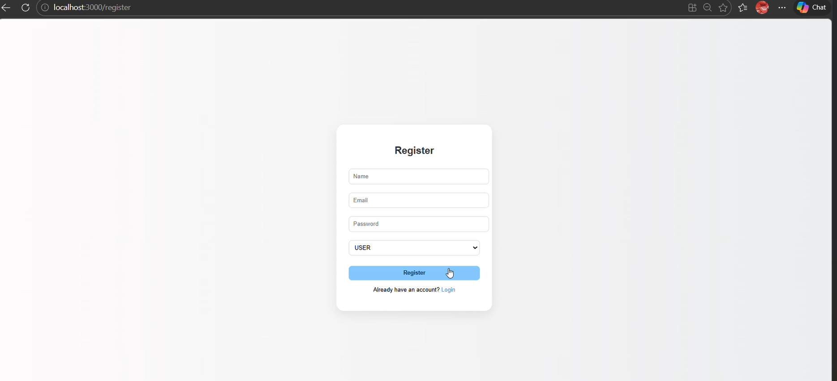
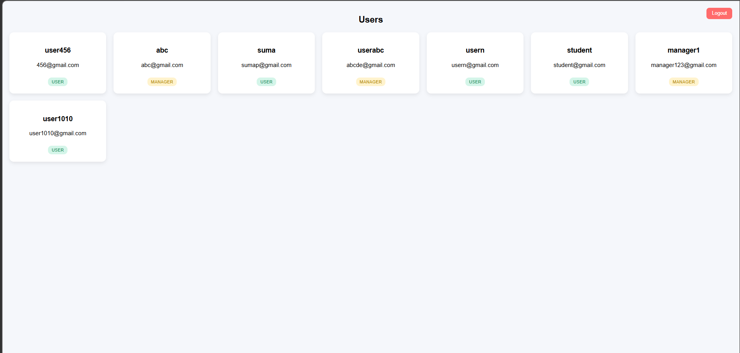
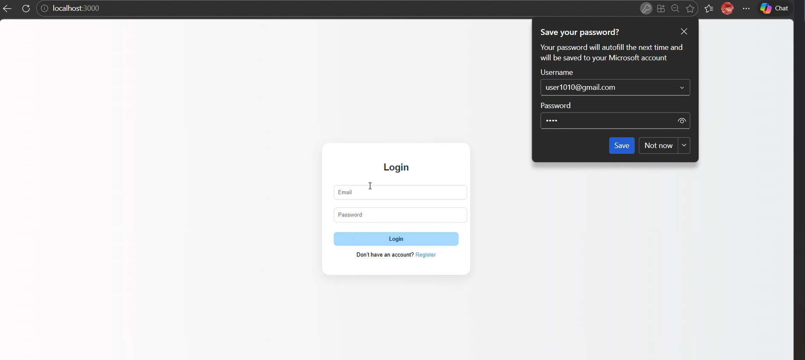
Website Demonstrating
Live Demonstration Link:https://drive.google.com/file/d/1eGukAPWaPL9xA2IX4YEunJrhr6WO11qY/view?usp=sharing

Slide 17
THANK
YOU

